Slide 1
CO452 Programming Concepts
Lecture 0
Introduction to the Module

Slide 2



The Aim of CO452
CO452 is intended to be an introduction to programming
Theory: Concepts of programming
Practical: Solving problems and writing solutions

Slide 3
Learning Outcomes

Slide 4




The learning objectives
Design, implement and test programs to solve simple problems
Correctly define fundamental programming concepts
Utilise best practice and professional conventions for quality code
Apply a systematic approach to develop a solution for a project

Slide 5
Module Scheme

Slide 6
Teaching format
For this module:
One hour lecture
- Theory of programming
- Quizzes
- Q&A
Two hour workshop session:
- Exercises

Slide 7
Module Scheme
Semesters are 15 weeks in length
CO452 is divided into three parts, each with a corresponding assessment
Module scheme is available on Blackboard and on the CO452 GitHub wiki

Slide 8
Module Scheme (1): CW1 (20%)
UW 1 | Variables, Main, IO | W1 exercises
UW 2 | Selection & Iteration | W2 exercises
UW 3 | Classes & Objects | W3 exercises
UW 4 | Collections: ArrayLists, Arrays & Lists | W4 exercises
UW 5 | Revision Quiz + CW1 Q&A | W5 consolidation exercises
UW 6 | Introduction to Greenfoot: Pyramid | CW1 due (20%)

Slide 9
Module Scheme (2): TCA1 20%
UW 7 | Greenfoot demo: | Greenfoot workshop
UW 8 | Greenfoot demo | Greenfoot workshop
UW 9 | TCA revision quiz + Greenfoot demo | Greenfoot workshop
UW 10 | (No lecture) : independent revision | TCA1 (20%)
UW 11 | TCA1 Feedback Session + BlueJ Game Demo | PR1 Workshop

Slide 10
Module Scheme (3): PR1 60%
UW 12 | Revision Quiz + PyGame Demo | PR1 Workshop
UW 13-15 | (Christmas Break) | (Christmas Break)
UW 16 | Presentation slot 1 for PR1 | Workshop for PR1
UW 17 | Presentation slot 2 for PR1 | Workshop for PR1
UW 18 | Presentation slot 3 for PR1 (60%) | N/A (module complete)

Slide 11
Language

Slide 12
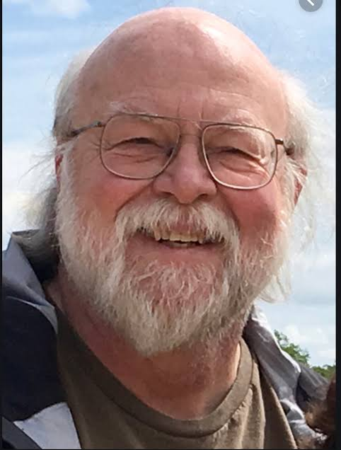
The Java Language
Java was published in 1995 by James Gosling of Sun Microsystems
Java is strongly typed (data types required) like C and C++ but utilizes a virtual machine (JVM) to run on multiple devices (portability)
C# was later developed in the early 2000s to compete with Java!

Slide 13
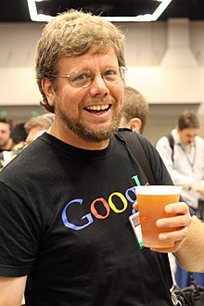
The Python Language
Python was published in 1991 by Guido Van Rossum
Python is a loosely typed (dynamic) language which doesn’t require types to be declared
Has grown in popularity due to data science, cyber security and AI applications

Slide 14
Software

Slide 15



Recommended IDEs
IntelliJ IDEA
GitHub Desktop
Visual Studio Code

Slide 16



Visual Studio Code
Smaller in size than the conventional Visual Studio and easier to get started. You can install languages and templates as and when required.
Can code and compile projects in all the major languages.

Slide 17
GitHub
GitHub is a version control system used in the industry
We’ll use it to backup your code, nicely formatted.
Wiki pages can also be used for documentation
Create an account at GitHub.com and download GitHub Desktop

Slide 18
Assessment

Slide 19
Formative assessment
Weekly exercises – these will help you practice and develop your skills. If you engage with these, you will be able to solve the summative assessment tasks.
Quiz questions – to test your understanding of concepts. Remember that theory is the foundation you build upon to solve problems.

Slide 20



Summative assessment
20
CW1 (small independent project)
TCA1 (MCQ test on concepts)
PR1 (team project and presentation)
20
60

Slide 21
CW1
Small independent project based on the basic concepts taught in the initial weeks of the module.
Task is bigger in scope than the weekly exercises, but if you have attended each week and attempt the exercises, you’ll be in a good position to solve this task.
Worth 20%
Design, implement and test programs to solve simple problems

Slide 22
TCA1
TCA consists of 20 multiple-choice questions, hosted on Blackboard
Select the correct definition
A feedback session will be held the following week
Measures LO2 and is worth 20%
Correctly define fundamental programming concepts
Notes:
“One of the best habits a learner can instill in herself is regular self-quizzing to recalibrate her understanding of what she does and does not know.”
Brown, Peter C.; Roediger III, Henry L.; McDaniel, Mark A.. Make It Stick (p. 21). Harvard University Press. Kindle Edition.

Slide 23
PR1
Team-based project – develop a game of your choice. It will test your project management and communication skills (but this is life).
We’ll help you get started with Green Foot, but also demo sample games in BlueJ and PyGame.
You will be required to give a small presentation on how you developed your game.
Measures LO3 and LO4 and is worth 60%
Utilise best practice and professional conventions for quality code
Apply a systematic approach to develop a solution for a project

Slide 24
Marking Criteria
CW1 (20%):
Testing of implemented features (80%)
Code quality (10%)
Documentation (10%)
TCA1 (20%):
Automated marking by MCQs (100%)
PR1 (60%):
Presentation (40%)
Demonstration of features (40%)
Documentation (10%)
Code quality (10%)

Slide 25
Marking Criteria (CW1)
 | Fail 0-34 | Marginal 35-39 | Satisfactory 40-49 | Good 50-59 | Very Good 60-69 | Excellent 70-79 | Outstanding 80-100
Testing of features (80%) | No testing | Minimal testing | Basic features tested | Half of the required features tested | Most requirements tested | All requirements tested | An added feature that ‘stands out’
Documentation (10%) | No wiki | Blank or template wiki | One or two elements included | Half of the elements included | One or two elements not included | All document- -ation present but one or two issues | No issues and outstanding features documented
Code Quality (10%) | Quality absent | Minimal attempt to include quality | Six or more quality issues | Four to five quality issues | Two to three quality issues | One minor quality issue | No quality issues

Slide 26
Marking Criteria (PR1)
 | Fail 0-34 | Marginal 35-39 | Satisfactory 40-49 | Good 50-59 | Very Good 60-69 | Excellent 70-79 | Outstanding 80-100
Presentation (40%) | No present- -ation | An attempt but poor quality | A good attempt | Some Technical errors | One or two technical errors | Seamless delivery and no technical errors | Goes above and beyond what is required
Demonstration (40%) | No demo | Fails to run | Basic features demonstrated | Half features demonstrated | Most requirements demonstrated | All requirements demonstrated | An added feature that ‘stands out’
Documentation (10%) | No wiki | Blank or template wiki | One or two elements included | Half of the elements included | One or two elements not included | All document- -ation present but one or two issues | No issues and outstanding features documented
Code Quality (10%) | Quality absent | Minimal attempt at quality | Six or more quality issues | Four to five quality issues | Two to three quality issues | One minor quality issue | No quality issues

Slide 27
The learning objectives
Design, implement and test programs to solve simple problems
Correctly define fundamental programming concepts
Utilise best practice and professional conventions for quality code
Apply a systematic approach to develop a solution for a project

